Slide 1
PhonePe Transaction Insights

Slide 2
We sincerely appreciate the opportunity to analyse the transactional dynamics, user engagement, and insurance-related data on PhonePe. Our analysis will include visualizations of payment category trends across states and districts, with a focus on identifying the top-performing states, districts, and PIN codes.

Slide 3

Transaction Dynamics on PhonePe

Slide 4
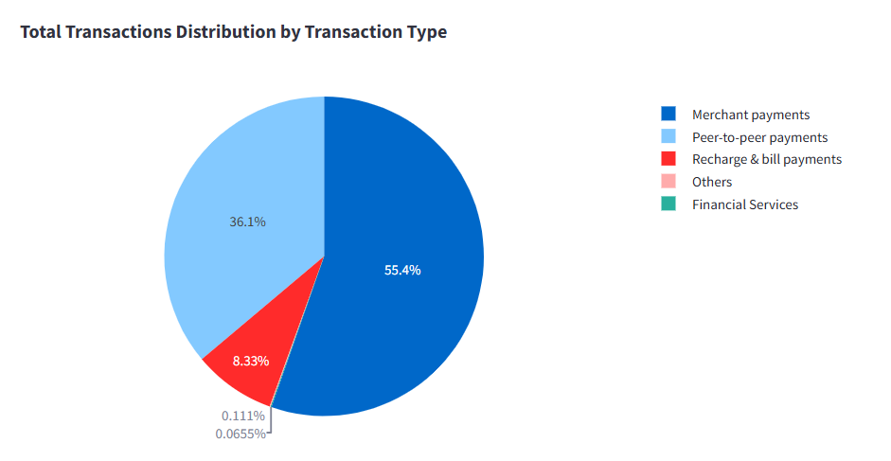
Transaction over Transaction Types
Merchant - Reflects a massive adoption of digital payment methods (like UPI, QR Codes, Cards) at retail stores, e-commerce, food delivery, travel, etc.
P2P - reflects that people are increasingly preferring cashless and contactless transactions for everyday purchases. Strong trust and comfort among users for using digital platforms even for small, personal transactions.
Recharge & Bills - Essential services, but relatively low in volume compared to Merchant and P2P payments.
Others - Could include transactions like government services, ticket booking, subscription renewals, charity donations, etc. No major impact on the overall transaction landscape.
Finance - Payments related to investments, insurance premiums, loan repayments, mutual funds, etc. Although currently small, Financial Services could grow rapidly in the future as digital financial literacy improves.

Slide 5
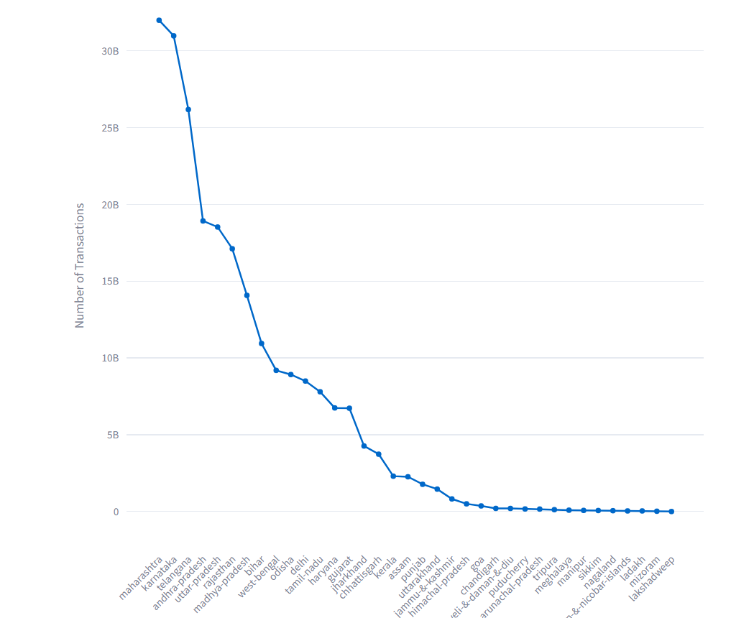
Maharashtra leads with the highest number of transactions, followed by Karnataka and Telungana.
Top Tier States (like Maharashtra, Karnataka, Telungana, AndhraPradesh) show extremely high transaction volumes, way above others.
There is a sharp drop-off after the top states, especially after the top 5-7 states.
Smaller states/UTs like Lakshadweep, Andaman & Nicobar Islands, and Sikkim have minimal transaction counts.
The distribution follows a long-tail pattern, where a few states contribute the majority of transactions.

Slide 6
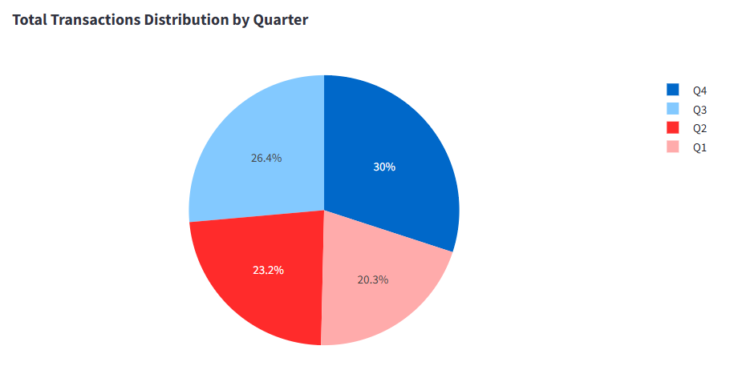
Trasaction Over Each Quarter
Q4 has the highest transaction volume, likely due to festive seasons (like Diwali, Christmas, New Year), year-end sales, and business closures, all encouraging more spending.
Q3 is also strong, possibly driven by the start of the festive shopping season and mid-year business activities.
Q2 and Q1 show lower transaction volumes, which could relate to relatively fewer festivals, vacation periods (summer holidays), and the start of the financial year where personal and corporate expenditures tend to be conservative.

Slide 7
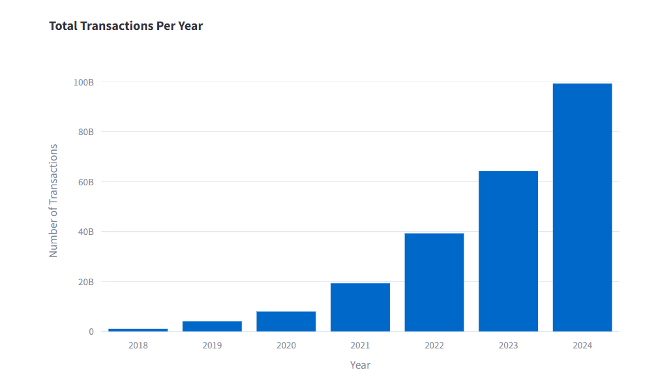
Transaction over the Years
Exponential Growth : The number of transactions has been increasing every year, with growth becoming much steeper after 2020.
2021–2024: It's accelerating. The jump from 2023 to 2024 is the largest ever, indicating massive user adoption and possibly new market expansions or innovations in payment systems.
Market Maturity: Early slow growth (2018–2020) represents adoption phases, later explosive growth (2021 onward) points toward maturity and widespread acceptance of digital transactions.

Slide 8

Device Dominance and User Engagement Analysis

Slide 9
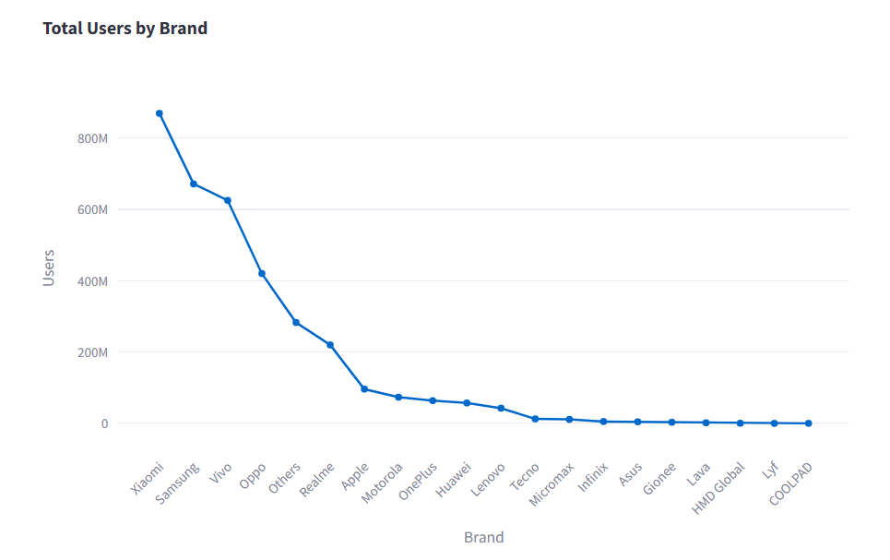
Device Dominance over Users
The market is heavily top, with Xiaomi, Samsung, Vivo, and Oppo accounting for the vast majority of users.
Cost-effectiveness and value-for-money offerings have been major drivers for the success of the top brands.
Smaller and legacy brands are struggling to retain or expand their user base in a highly competitive market.

Slide 10
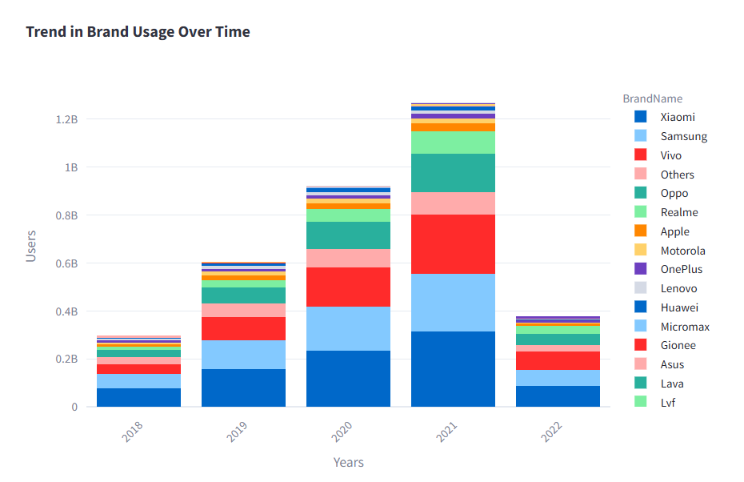
Brand Usage over TimePeriod
Xiaomi, Samsung, Vivo, Oppo, and Realme are the clear winners, contributing to the majority of smartphone users.
The Chinese brands dominated the market expansion between 2018 and 2021.
Like Apple ,OnePlus, Motorola remain consistent but do not experience the growth seen with the top players.
Others (smaller brands) maintained a stable but declining proportion over time, as bigger brands consolidated their dominance.

Slide 11
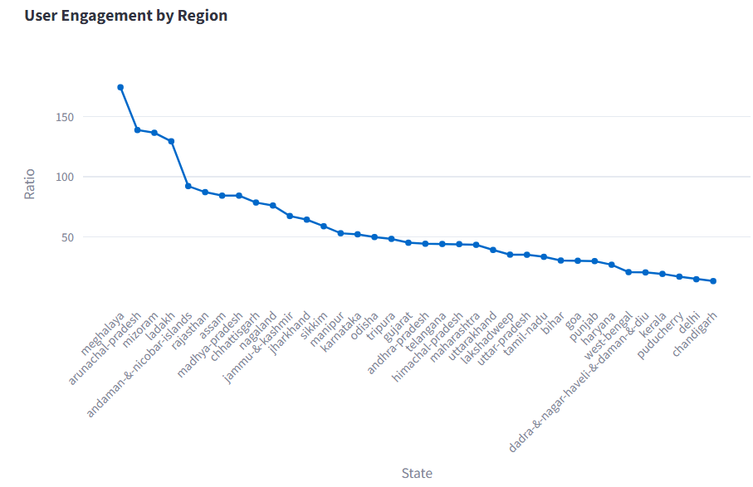
Engagement over Regions
Smaller and Northeastern states (Meghalaya, Mizoram, Arunachal Pradesh) show significantly higher engagement than larger, metropolitan regions.
Union Territories like Andaman & Nicobar and Ladakh also perform better than expected in engagement despite smaller populations.
Urbanized states and cities may have wider access to devices, but relatively fewer active users.
Lower-tier states like Bihar and Odisha are positioned mid-to-lower but still outperform some urban hubs.

Slide 12
User Engagement and Growth Strategy

Slide 13
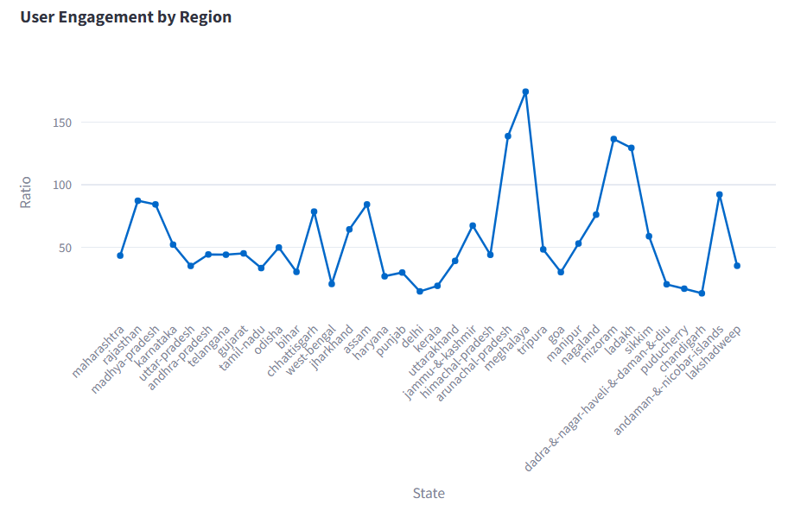
User Engagement per Region
Smaller states and Union Territories like Meghalaya, Mizoram , Arunachal Pradesh and Nagaland are showing surprisingly higher engagement compared to larger, more populous states.
Northern and Western Indian states generally have mixed engagement, while some North-Eastern states perform really well (like Nagaland and Mizoram).
Engagement seems less correlated with population size and possibly more tied to other factors like localized campaigns, connectivity, or specific initiatives.

Slide 14
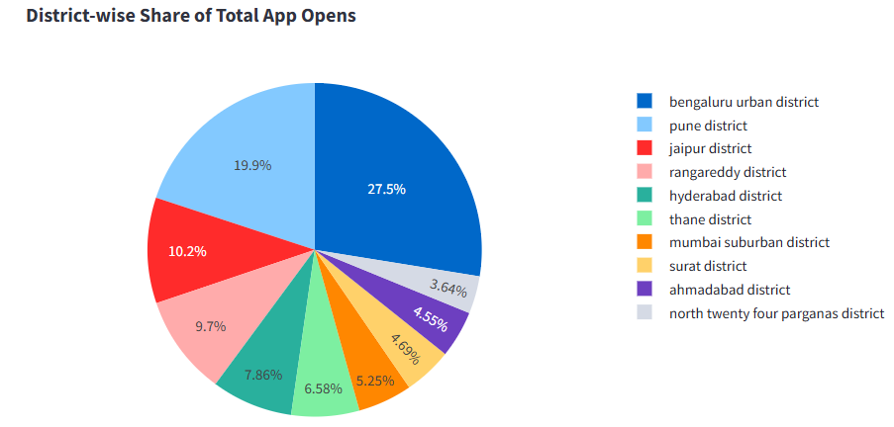
App Engagement Metrics Across Leading Districts
Together, these top 5 districts account for about 75% of total app opens showing a high concentration of activity.
Explore expansion strategies in lesser-engaged urban areas.
Consider localized promotions or city-specific campaigns for Bengaluru and Pune to further boost engagement.

Slide 15
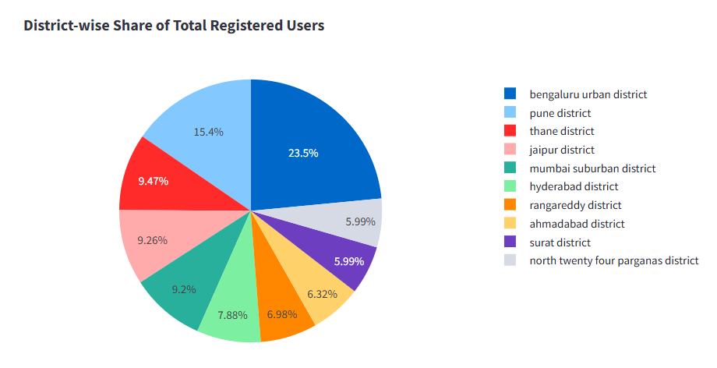
Total users share over District
Again, urban regions dominate user registrations.
South Indian cities (Bengaluru, Hyderabad, Rangareddy) and Western cities (Pune, Thane, Mumbai) are driving the major share of registrations.
Bengaluru’s dominance is slightly lower here (23.5%) compared to its app open share (27.5%), indicating that while many users are registered there, the engagement (app opens) is even stronger.

Slide 16
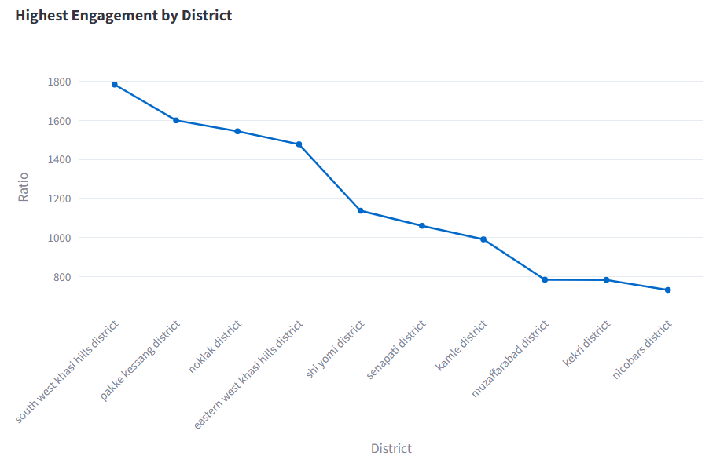
Top Engagement over District
Northeastern regions dominate high engagement indicating possibly active user bases even if the total user count might be low.
Smaller population districts might be showing higher per-user activity, meaning a highly involved audience.
After the top 4-5 districts, there’s a sharp decline showing engagement flattens out beyond.

Slide 17

Insurance Engagement Analysis

Slide 18
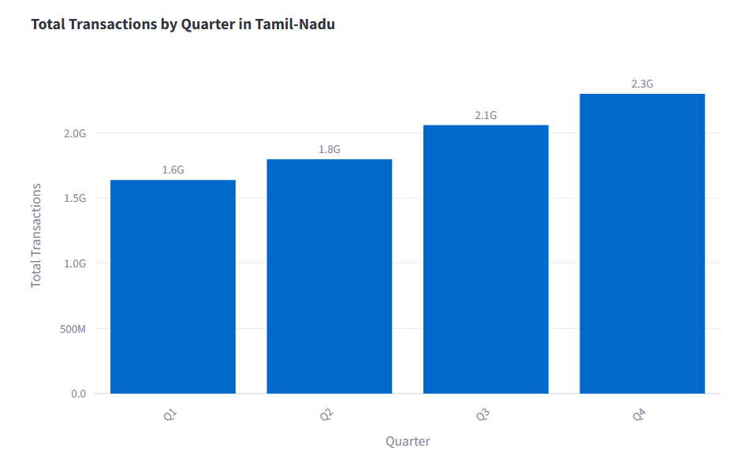
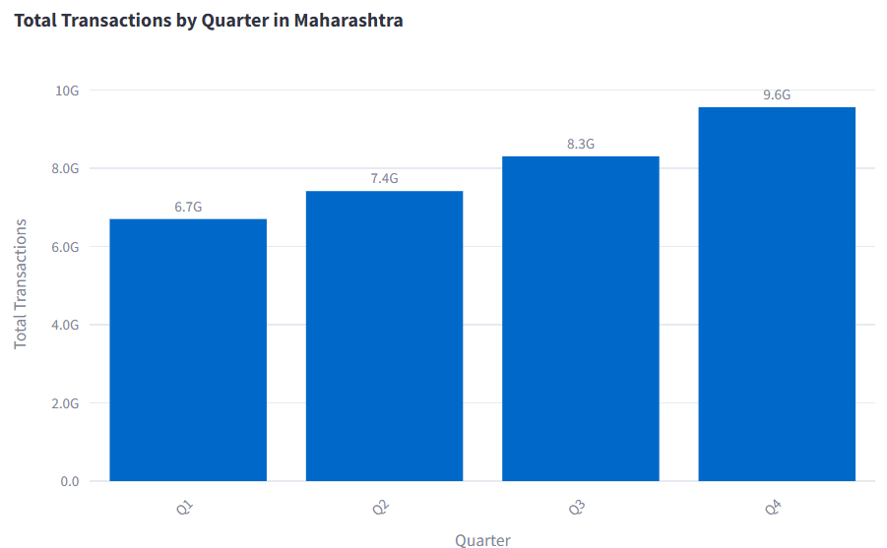
State-wise Insurance Transaction Trends by Quarter
Maharashtra's transaction volume is approximately 4–5x that of Tamil Nadu.
Both states are growing quarter after quarter, reflecting a positive insurance adoption trend.
Maharashtra's larger base might indicate a higher maturity, while Tamil Nadu is building momentum that could sustain long-term growth.
The peak in Q4 across both states suggests a seasonal effect like fiscal year closing, tax planning, or insurance promotions.

Slide 19
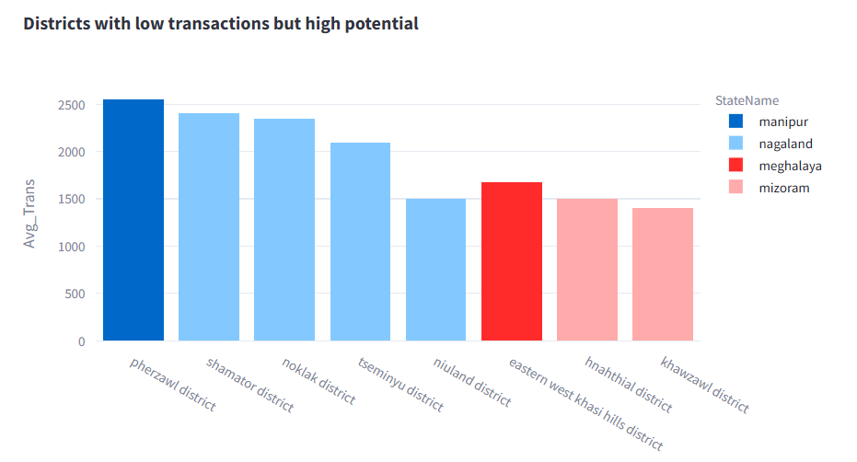
High Potential over District
This suggests Nagaland has a latent demand for digital or insurance services.
These districts, although currently low in total transactions compared to national averages, display higher than expected engagement.
Present an opportunity to expand market share through localized campaigns, partnerships with regional players etc.,

Slide 20
Transaction Analysis Across States and Districts

Slide 21
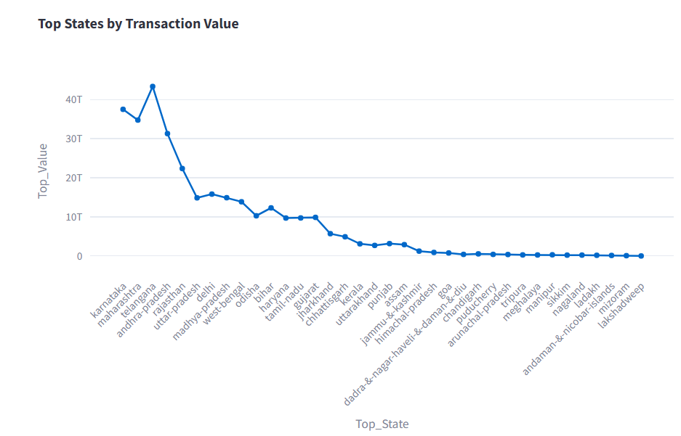
Top Values over States
Telugana, Karnataka and Maharastra leads significantly, with transaction values reaching above 40T, indicating a strong digital and financial ecosystem.
States like Lakshadweep, Andaman & Nicobar Islands, Nagaland, Mizoram, and Sikkim are at the bottom, showing very low transaction values.
Possible reasons include smaller populations, logistical challenges, and lower digital adoption.
Invest more in mid-performing states helps to move them to the top tier.

Slide 22
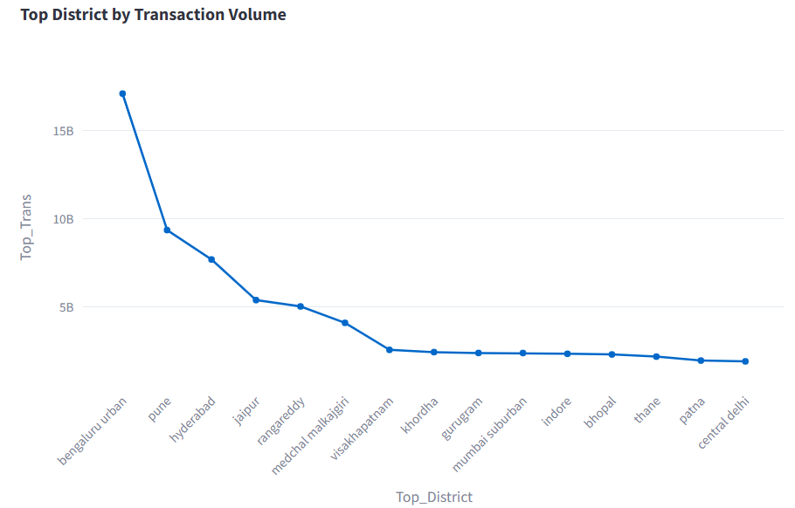
Top District based on Higher Transaction
Bengaluru, Pune, and Hyderabad collectively dominate transaction volumes, underlining the urban concentration of digital transactions.
After Medchal-Malkajgiri and Visakhapatnam, there is a noticeable gradual drop in transaction volumes, indicating more fragmented growth across districts.
Districts outside top metros can grow further with better digital infrastructure, awareness campaigns, and targeted financial products.

Slide 23
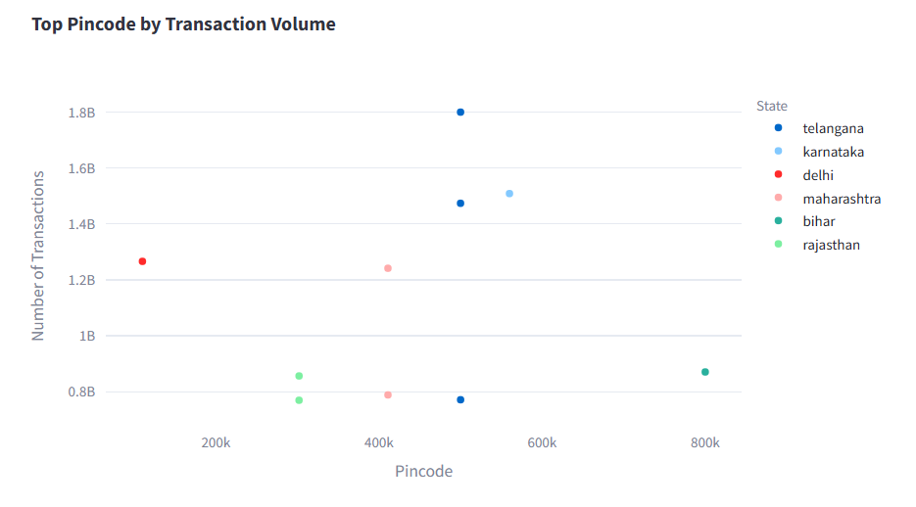
Trasaction Volume over District Pincode
Telangana and Karnataka lead massively over others urban pincode zones dominate digital transactions.
Bihar and Rajasthan pincode clusters, are starting to show real momentum, a good signal for future expansion and focus.
Identifying new rapidly growing pincodes within Maharashtra beyond Mumbai could open additional digital transaction.
Launch new product launches and premium services can lead to high transaction increments.

Slide 24
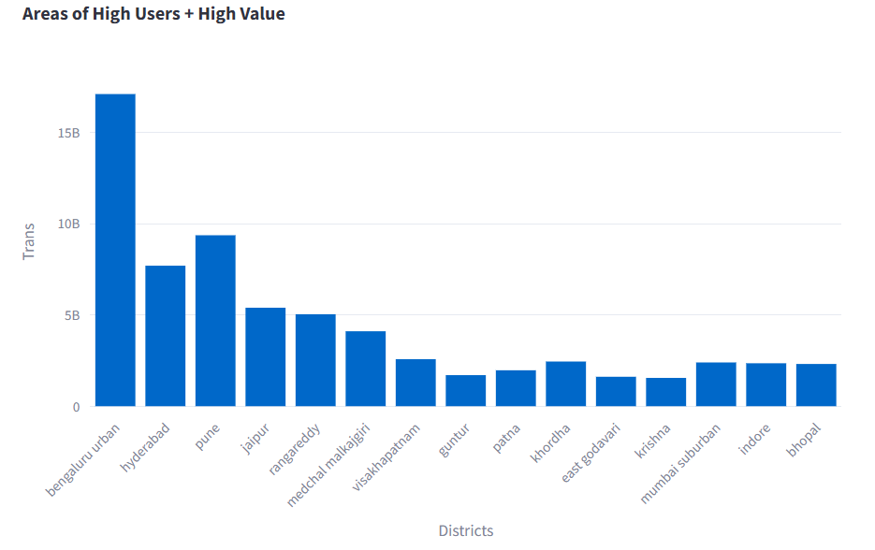
District wise Top Transaction User&Value
Bengaluru Urban, Hyderabad, and Pune dominate because of higher education levels, tech employment, and digital infrastructure.
Top Tier-2 Stars (Jaipur, Patna, Indore, Bhopal). These cities are growing fast - good opportunity for to grow more in services, e-commerce, finance etc.,
Focus campaigns and digital services not just in cities but their surrounding suburban districts.

Slide 25
Thank you
Avinache. M
GUVI Team
Data Analyst

